Slide 1
A Workshop for NNMC Students
Dr. Lara Wallace, Facilitator
In collaboration with NNMC Career Services
© English for Sustainability, LLC (2024)

Slide 2
Are you interested? Workshop Overview
4 Reasons Why Using LinkedIn Can Help Your Career
Planning The First Impression You Want to Make
How to Look for Internships
Checklist for Creating Your Profile
Notes:
Help you stand out from the others at the career fair and when applying to jobs and internships!

Slide 3
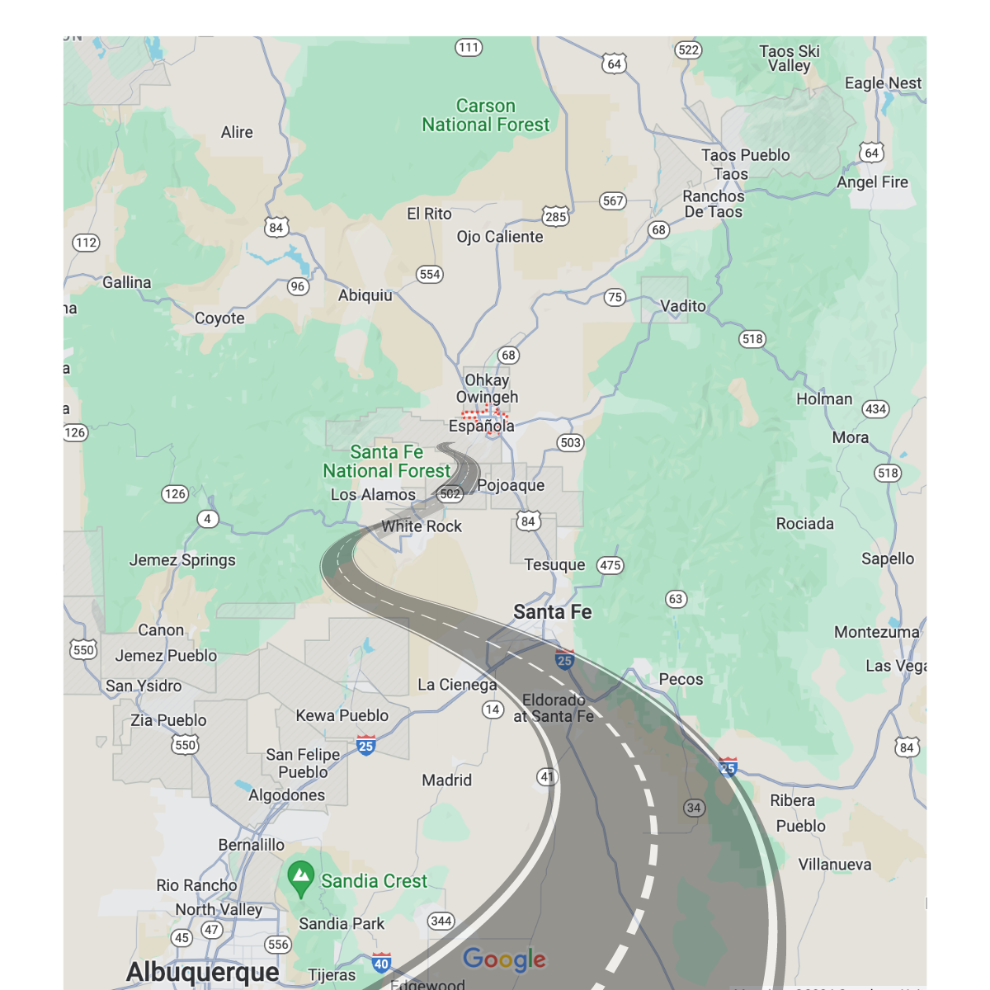
Landing an internship is easier when people know you.
Agree?
Disagree?
It depends?
Notes:
I live in Athens. Ohio.
In Appalachia
19k people
Few jobs: university, healthcare…
I worked in ELIP, helping students present their research and ITAs.
BUT the university cutting jobs

Slide 4
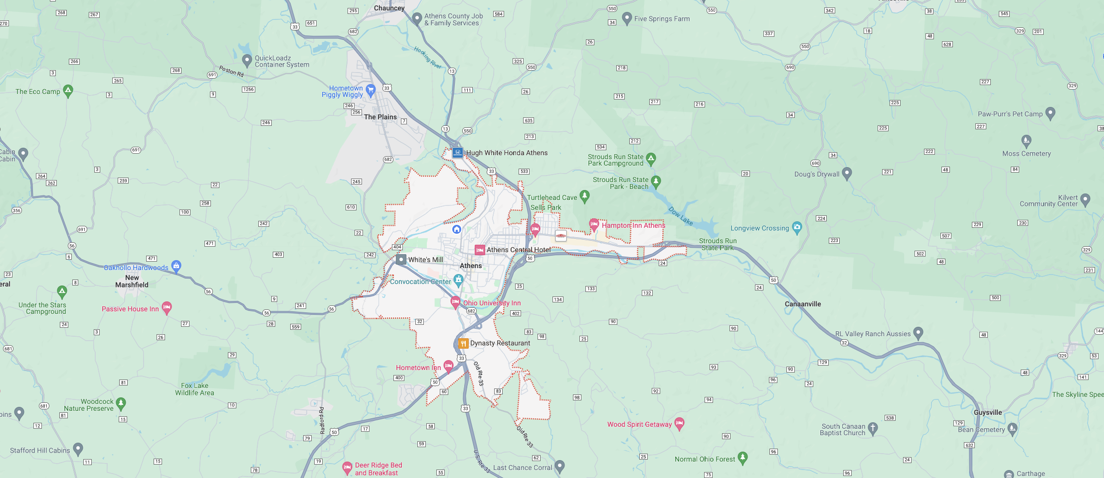
My LinkedIn Journey
Reactivated account in 2019
Opportunity knocked: A business coach found me and helped me start English for Sustainability, LLC
Studied how to use LinkedIn in with multiple business coaches
Connected with sustainability professionals and enthusiasts
Joined groups related to sustainability, renewable energy, conservation, agroforestry
Grew to over 9k followers, over 8k connections
Host and attend events
Create, read, and comment on content
Engage with a global community
Notes:
LONG-TERM CAREER PLANNING
In a given day, I talk with people from…
Remote work and local opportunities

Slide 5
4 Reasons for Using

Slide 6
Reason 1: Expand Your World Beyond NNMC
Notes:
Whether you want to stay at home and work remotely like I do, or whether you want to find in-person opportunities, LI can help.

Slide 7
Reason 2: Meet People Who Can Help
Follow Top Voices (experts)
Join groups by interest or industry
Attend online events
Read comments under posts

Slide 8
Notice Opportunities to Connect (Include a note with your connection request)
Post: “I loved your post about X because… It’d be great to connect.”
Comment: “That was a great comment you made on X’s post. I’d love to connect.”
Event: “I noticed you also attended X event. It’d be great to connect.”
Hiring managers: “I’m impressed with [company] because…and was wondering whether there are any upcoming positions requiring my skills as a X”
They have a job you want to learn more about: “I’m a student looking for jobs in X and would love to connect with people in the industry.”

Slide 9
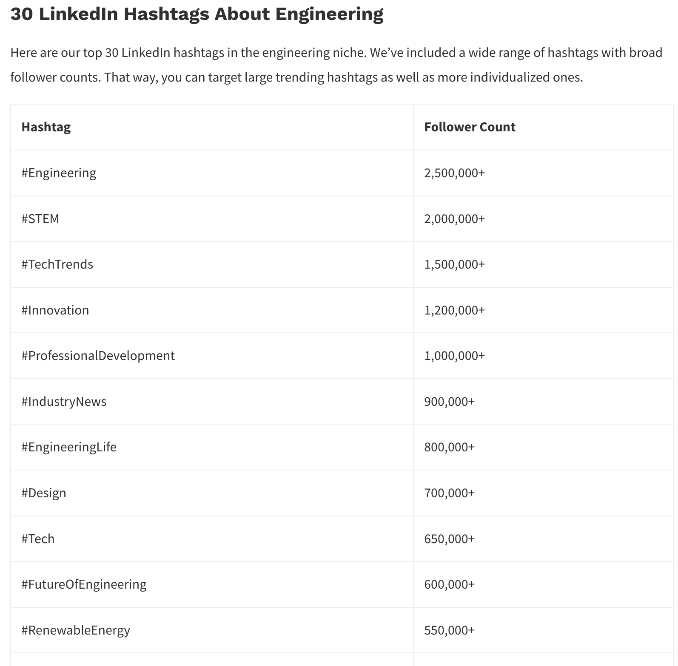
Reason 3: Find Professional Opportunities
Use the search bar (by industry, company, position, location, group, etc.)
Join professional and interest groups
Network with people (hiring managers are decision makers)
Follow relevant hashtags (#)
From We-Connect (Aug. 10, 2023)

Slide 10
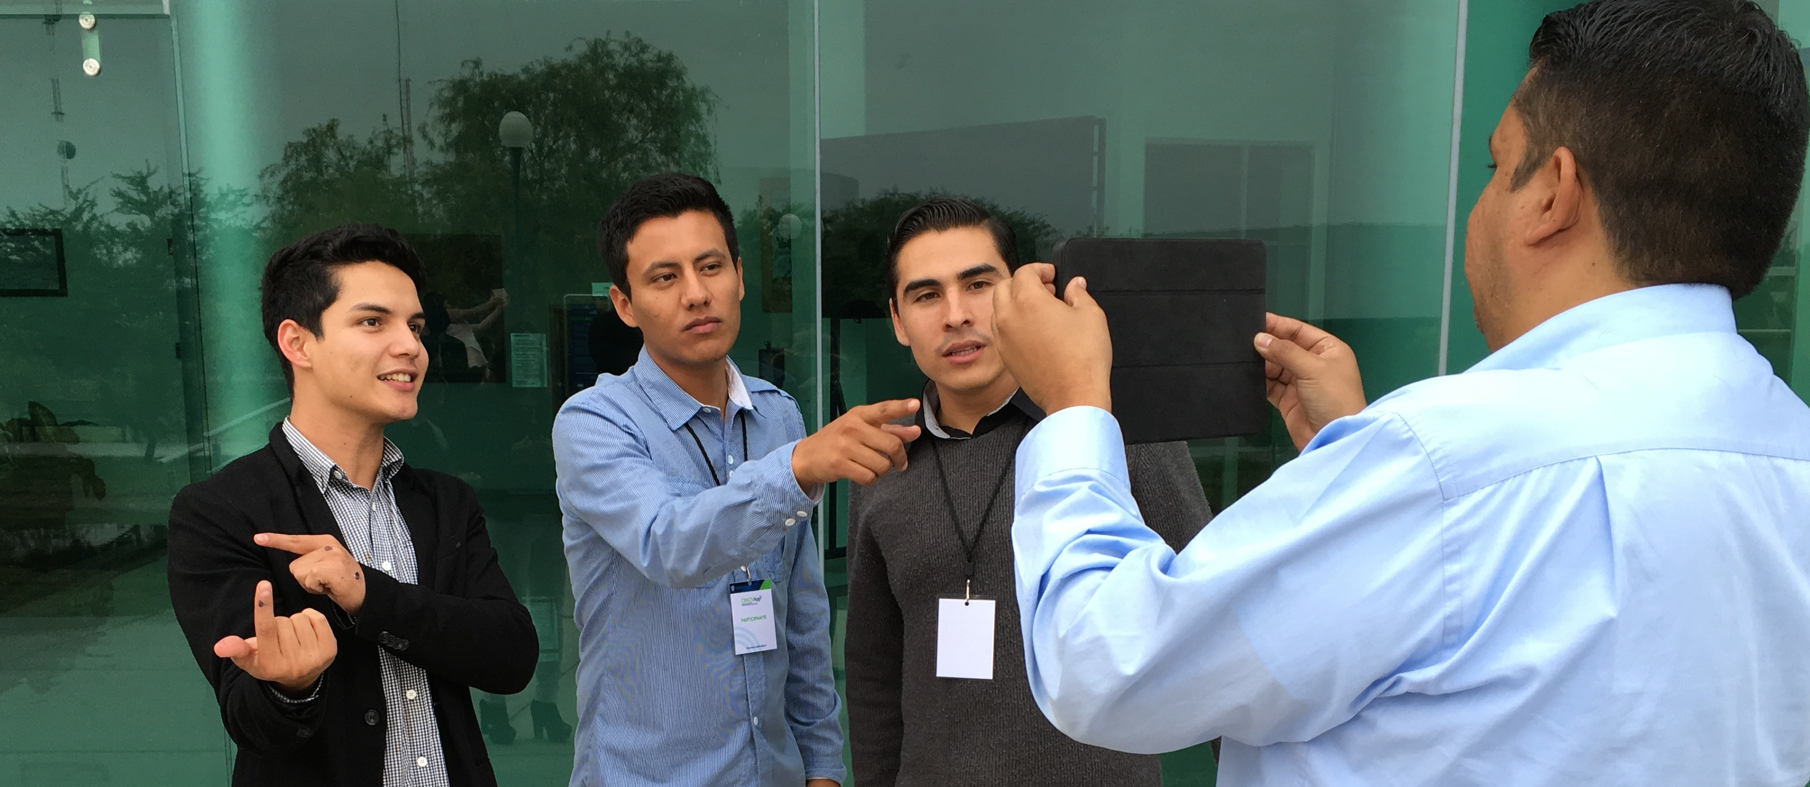
Reason 4: Create Your Professional Persona

Slide 11
Your Profile is Dynamic & Forward-Looking!
Post for what you WANT, not your current position.
Tailor it to the type of internship or job you are seeking.
Share your achievements (don’t worry, you’re not bragging).
Let people get to know you on your terms (use the privacy features and settings).
Highlight your competence with your resume & achievements.
Cultivate trust by engaging with people and posts, recommendations.
Write your own posts, repost items of interest.
Feature the most outstanding posts and achievements.

Slide 12
Anatomy of a Profile
Not pictured:
Featured
Activity (posts, comments)
Experience
Education, Honors & Awards
Licenses & Certifications
Skills, Languages
Projects, Courses, Volunteering
Recommendations
Notes:
Most people see only your photo and headline. Some see this when clicking on your profile. Few read more.

Slide 13
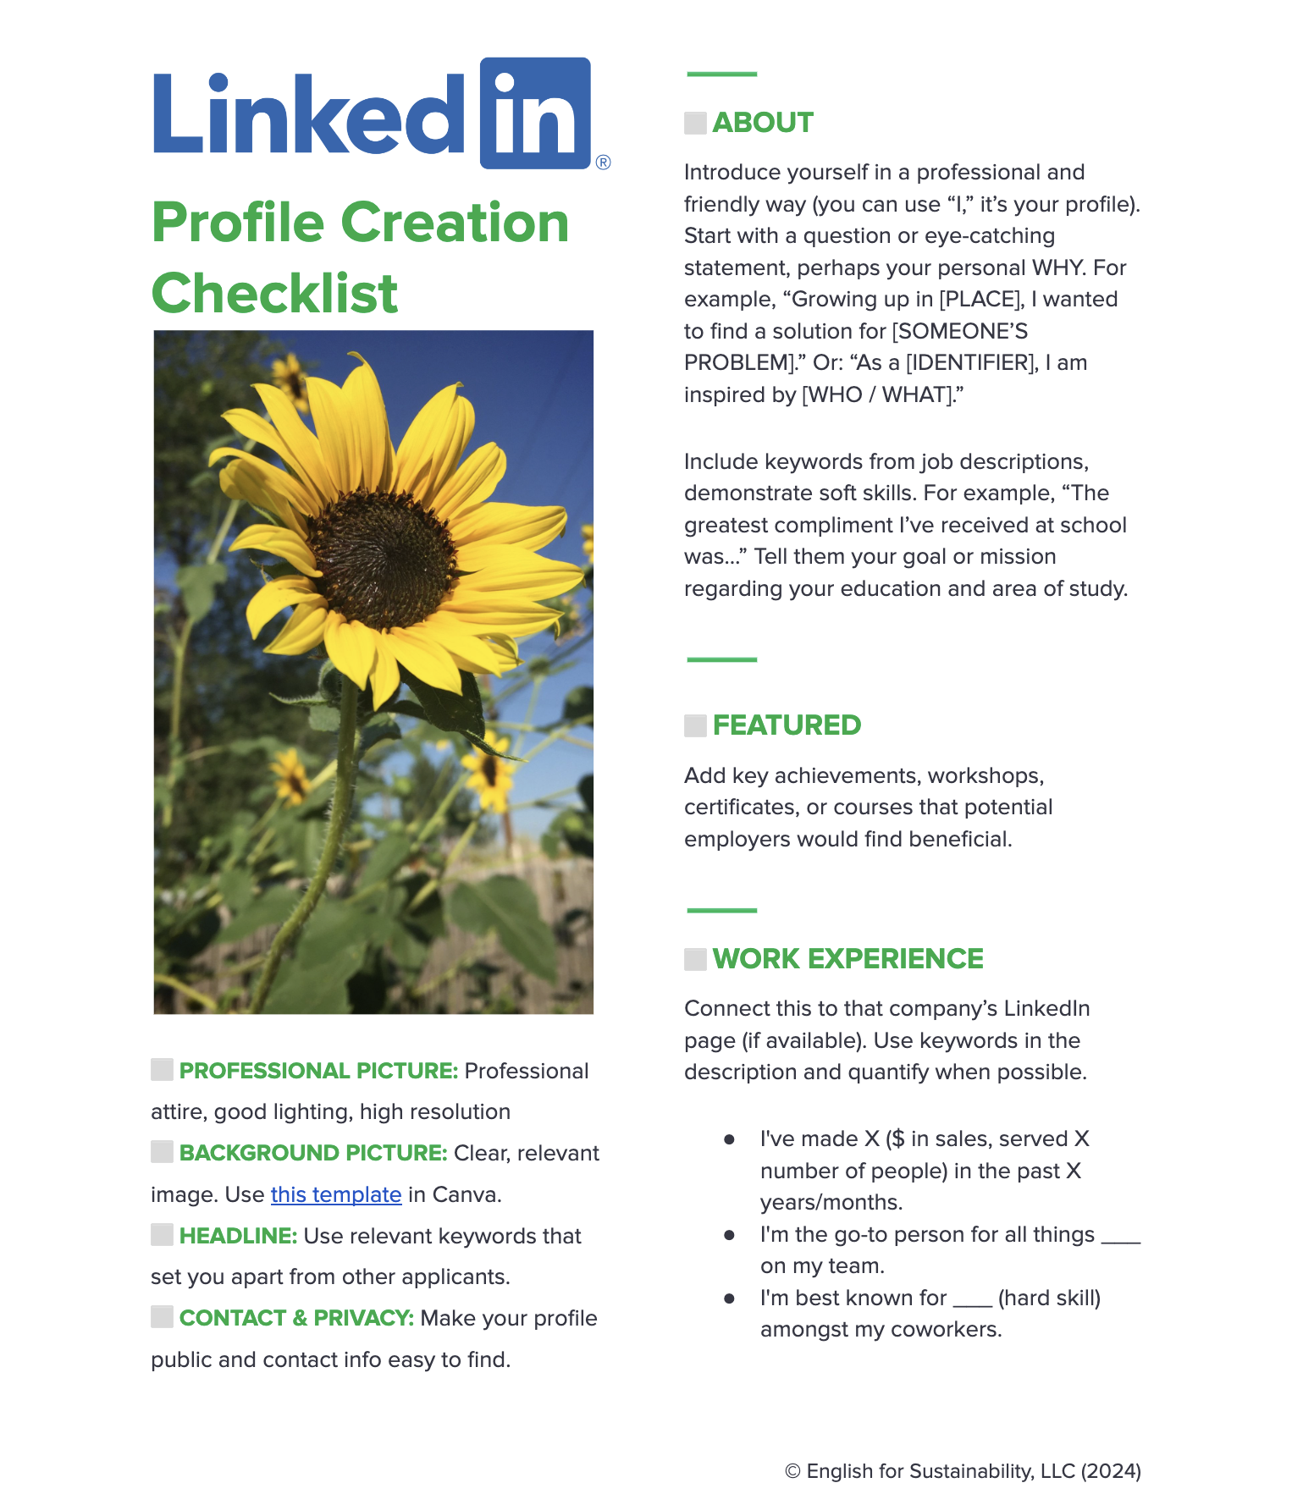
LinkedIn Profile Creation Checklist
This handout to help you refine your profile.
Click here!
Notes:
Stay tuned for a special opportunity and reward for using this handout!

Slide 14
Planning Your First Impression

Slide 15
Decide who to interview!
18
Skilled Applicants
5 Interviews
1
Hire
Applicant Qualities:
Competent
Approachable
Trustworthy

Slide 16
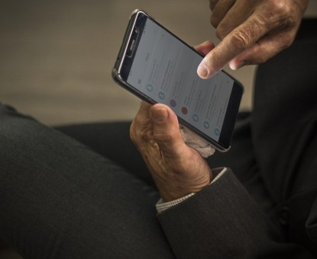
Our 18 Applicants
WHO STOPS THE SCROLL?
Who will you consider interviewing?
PS: Let’s be considerate. These are real people.

Slide 17
What’s your impression?
Competent?
Approachable?
Trustworthy?
Lacks competence
Difficult to approach
Untrustworthy

Slide 18
What’s your impression?
Competent?
Approachable?
Trustworthy?
Lacks competence
Difficult to approach
Untrustworthy

Slide 19
What’s your impression?
Competent?
Approachable?
Trustworthy?
Lacks competence
Difficult to approach
Untrustworthy

Slide 20
What left an impression on you?

Slide 21
Consider the kind of impression you want to make with your profile.
_______________________________________________
_______________________________________________
_______________________________________________
_______________________________________________
_______________________________________________
_______________________________________________
_______________________________________________
_______________________________________________
Notes:
Remember, if you’re on campus, you can get your professional photo taken immediately after this!

Slide 22
Looking for Internships on

Slide 23
Searching for Internships

Slide 24
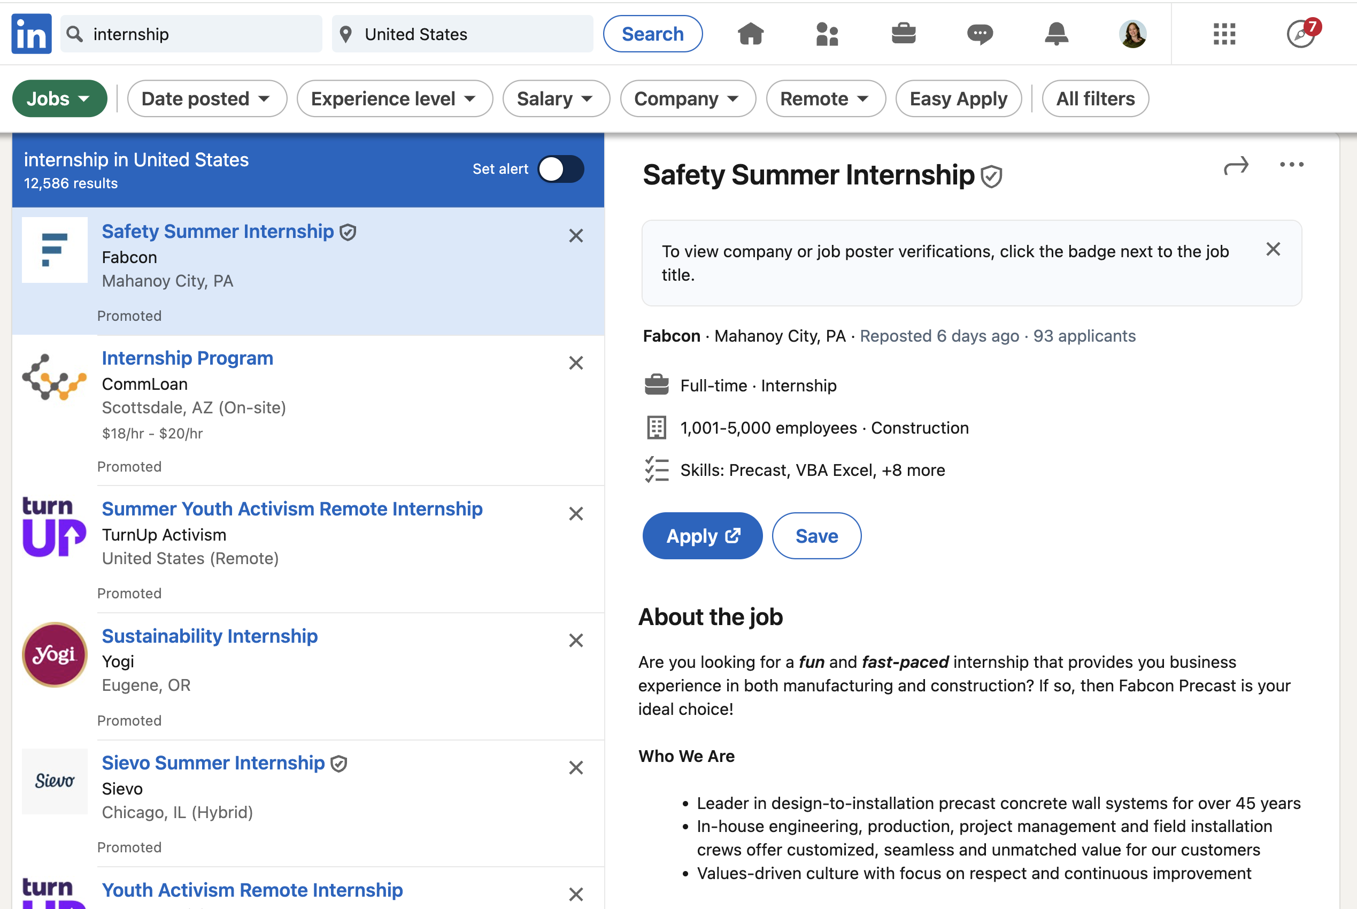
Use Search Filters: “Jobs”

Slide 25
Use “Save Job” to Keep Track of What Interests You

Slide 26
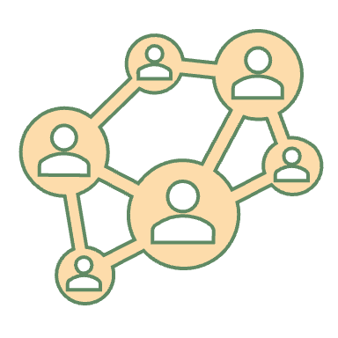
Networking for Internships

Slide 27
Who’s in Your Community
Family & Friends
NNMC & Work Relations
LinkedIn Groups & Members

Slide 28
People You Know: Your 1st degree connections
Read shared information & opportunities
Gain access to their network (their connections are your 2nd degree connections = easier to meet!)
Ask for endorsements of your skills
Request recommendations
Notes:
Examples: LANL: who do you know who has interned or worked there? Connect with them.
Connect with people who you know: supportive aunties, uncles, cousins, other people (tell them about my dad).
Sara McCormick with Career Services.
Ashley Duemmler can help you with STEM internship opportunities, career exploration, job/internship search strategies, building your resume, cover letter, or practice for your next interview

Slide 29
Groups: These are doors to your professional community. 2nd and 3rd degree connections

Slide 30
4 Groups You Should Join
Internships and Interns
(63k members)
Entry Level Jobs and Internships: College Recruiter
(58k members)
College Grad Recruiting
(24k members)
A Job Needed, A Job Posted
(54k members)

Slide 31
Here’s What You’ll Find in Groups
Events
Posts
Conferences
Professional Development Opportunities
Community Icons & LinkedIn’s Top Voices

Slide 32
Good Reasons to Follow Content Creators
Learn from their posts
Save the important ones (“My items”)
Freebies, challenges, and courses
Join their communities
Connect with people in the posts!

Slide 33
Checklist for Creating Your Profile on

Slide 34
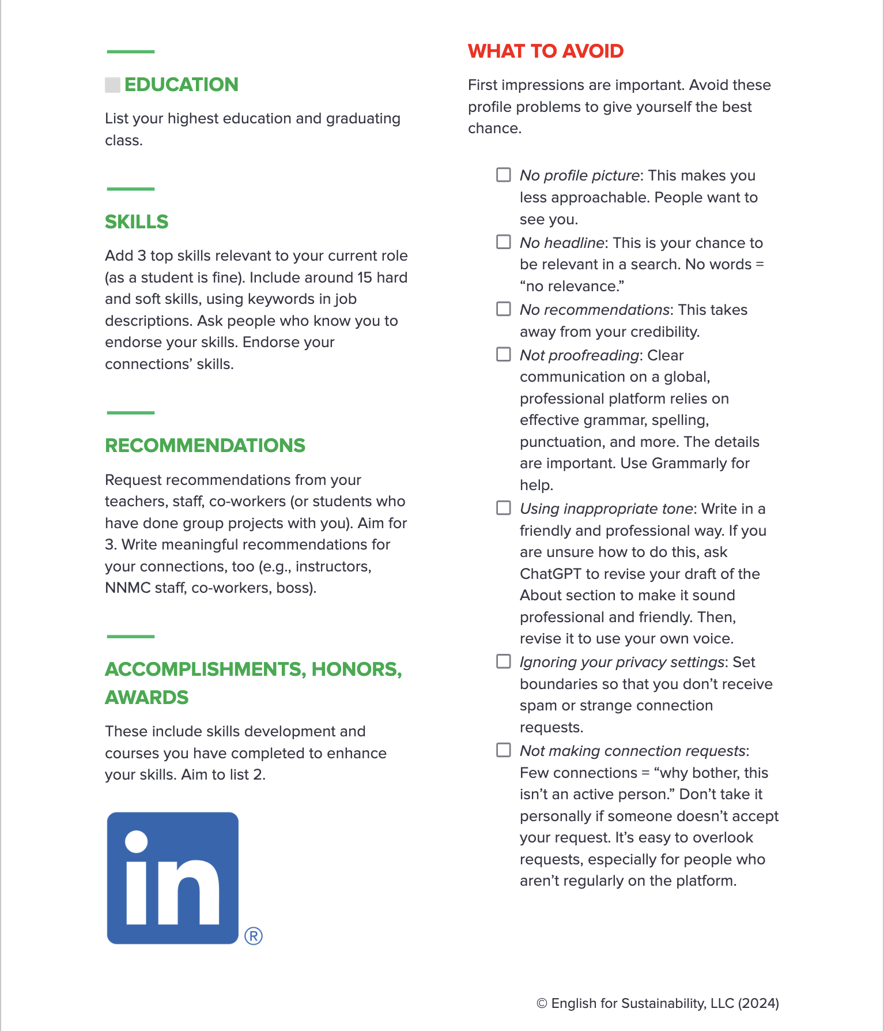
Notes:
Stay tuned for a special opportunity and reward for using this handout!

Slide 35
Are you ready to boost your career on LinkedIn?
4 Reasons Why Using LinkedIn Can Help Your Career
Planning The First Impression You Want to Make
How to Look for Internships
Checklist for Creating Your Profile
Best wishes and feel free to connect with me.
Lara Wallace, PhD & lara@english4sustainability.com

Slide 36
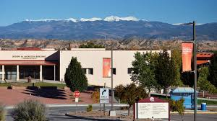
Next Step: Visit the Career Center to get started!
Location AD 283A
Email studentjobs@nnmc.edu
Sara McCormick: 505-747-2120

Slide 37
Certificate: Deadline is April 12th: Create & Connect!
Create your profile
Photo
(Banner)
Headline
About
Expected Graduation Date
Connect with Sara McCormick of NMMC Career Services
Notes:
Make an appointment with Career Svcs (studentjobs@nnmc.edu) to come set up your linkedin profile. Use career center computer stations!

